Slide 1
K-ICT 기술사업화 페스티벌 사업화 유망 기술이전설명회
초고해상도 비디오 코덱 SoC
- HEVC Video Codec
2015. 8. 26.
멀티미디어프로세서연구실
한국전자통신연구원

Slide 2

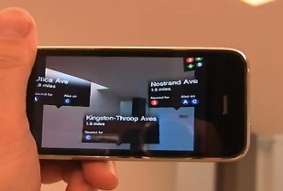
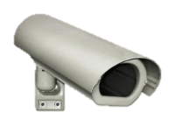
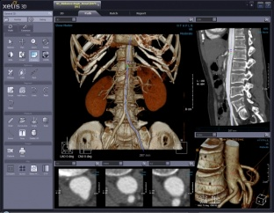
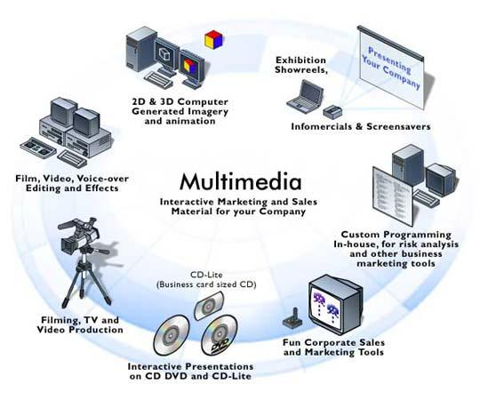
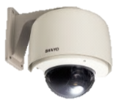
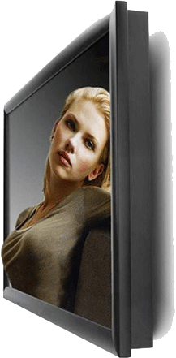
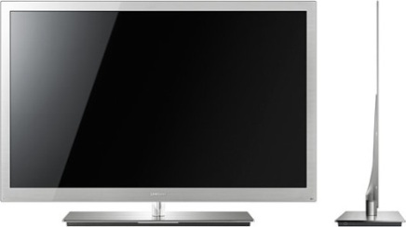


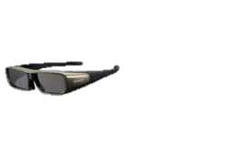
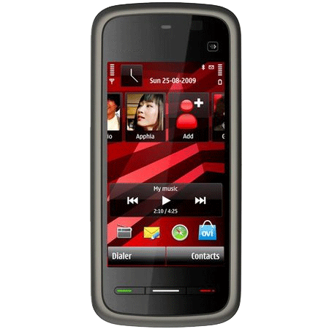
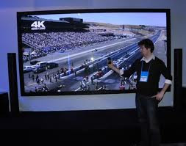
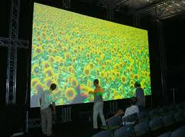
기술의 필요성
초고해상도 콘텐츠 및 대형 디스플레이 장치 진화
고해상도 스마트폰
고화질 Security
Medical image
초고해상도 콘텐츠
Hologram Projection
Home Entertainment
Data Storage
3D TV
(Samsung, Sony, Phillips..)
4K UHD Smart TV
8K 디지털 시네마
CONTENTS
Full-HD (2K) Resolution
4K-UHD
8K-UHD
DISPLAY DEVICE
Full-HD(2K) Panel
(1920X1080, 2M Pixels)
4K-UHD Panel
(3840x2160, 8M Pixels)
8K-UHD Panel
(7680x4320, 32M Pixels)
2010
2013
2016
Notes:
The feature of EMP is summarized as ultra-low-power, small and fast signal processing.
We view the markets for EMP as audio and real-time control.
As the microcontroller requires more and more real-time control, we believe that microcontroller may need DSP features implemented in the embedded core.
The microcontroller platform based on EMP includes IPs for MCU and EMP core as the central processing core.

Slide 3
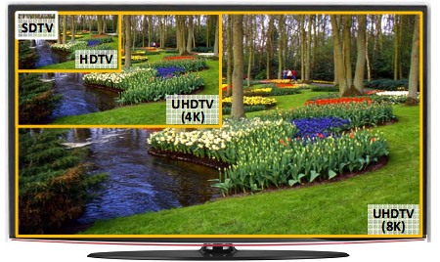

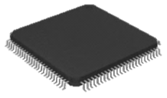
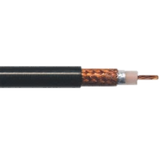


기술 개요
HEVC(High Efficiency Video Coding) 코덱
초고해상도 영상의 데이터 전송량을 줄이기 위해 영상을 압축/복원하는 기술
Full-HD(2K), 4K/8K-UHD 영상압축
H.264 대비 압축효율 2배 이상
고해상도 비디오용 병렬처리
HEVC
HEVC
...010101001101011010101...
비디오 압축
(100:1 이상)
비디오 복원
 | MPEG-4 | H.264/AVC | HEVC
표준 제정 년도 | 1998 | 2003 | 2013
최적 해상도 | SD(720x480) | HD(1280x720) Full-HD(1920x1080) | 4K-UHD(3840x2160) 8K-UHD(7680x4320)
압축 효율 | 1x | 2x | 4x
요구 계산량 | 1x | 2x | > 8x
Notes:
The feature of EMP is summarized as ultra-low-power, small and fast signal processing.
We view the markets for EMP as audio and real-time control.
As the microcontroller requires more and more real-time control, we believe that microcontroller may need DSP features implemented in the embedded core.
The microcontroller platform based on EMP includes IPs for MCU and EMP core as the central processing core.

Slide 4
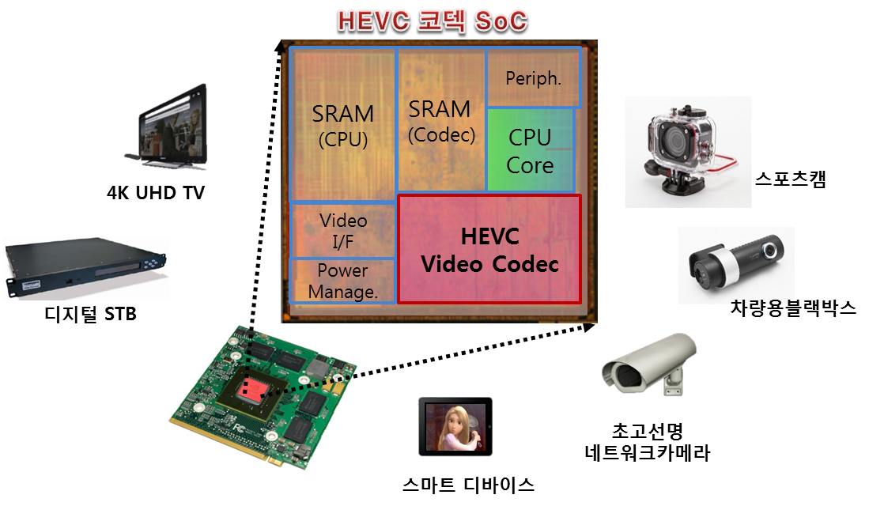

적용 분야
비디오 서비스 관련 응용분야에 폭넓게 적용가능
Notes:
The feature of EMP is summarized as ultra-low-power, small and fast signal processing.
We view the markets for EMP as audio and real-time control.
As the microcontroller requires more and more real-time control, we believe that microcontroller may need DSP features implemented in the embedded core.
The microcontroller platform based on EMP includes IPs for MCU and EMP core as the central processing core.

Slide 5
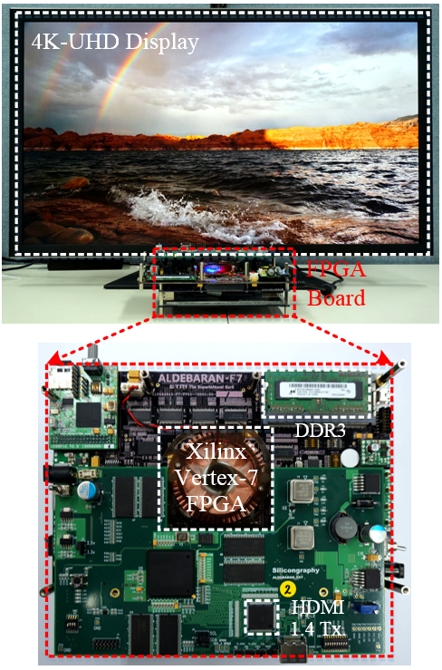
HEVC Decoder IP : Supernova
Category | Specification
Profile and Level | HEVC Main profile @ 4.1
Max. performance | 2K@120fps (Single-core, 400 MHz) 4K@60fps (Dual-core, 400 MHz)
Max. bitrate | 50Mbps 처리 가능 (High tier)
Operation freq. | 200 MHz (FHD@60fps)
Main system bus | AMBA AXI 128bit
Mem. interface | DDR2/3
Ref. HM(SW) version | HM-13.0
Features | ● HEVC WPP, Tiles 병렬처리 기술 ● 독립적인 multi-core 구조 (4K/8K) ● No extra HW for bound. filtering ● 전용 하드웨어 SoC 기술
2013년 4Q FPGA 검증
Notes:
The feature of EMP is summarized as ultra-low-power, small and fast signal processing.
We view the markets for EMP as audio and real-time control.
As the microcontroller requires more and more real-time control, we believe that microcontroller may need DSP features implemented in the embedded core.
The microcontroller platform based on EMP includes IPs for MCU and EMP core as the central processing core.

Slide 6
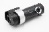
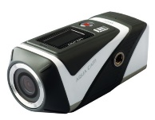

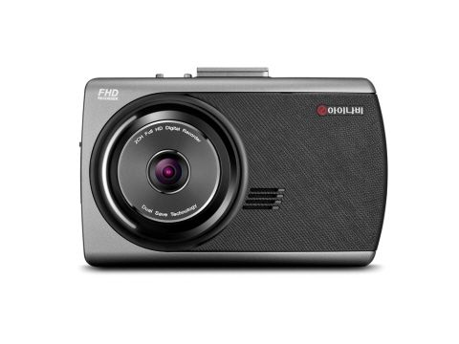
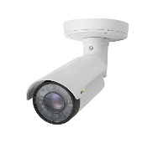

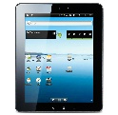
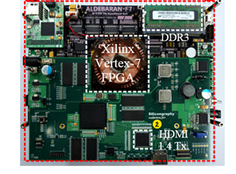
HEVC Encoder IP : Hypernova
Category | Specification
Profile and Level | HEVC Main profile @ 4.1
Max. performance | 2K@60fps (Single-core) 4K@30fps (Dual-core)
Compression ratio | H.264 대비 약 1.5배 압축율 개선
Max. operation freq. | 300MHz (FHD@60fps)
Main system bus | AMBA AXI 128bit
Memory interface | DDR2/3
Ref. HM(SW) Version | HM-13.0
Features | ● Tile based 병렬처리 기술 (4K) ● 8x8 CU 기반 최적 예측모드결정 기술 ● Transform 스킵 저전력 기술 ● 전용 하드웨어 SoC 기술
차량용 블랙박스
스포츠캠
시큐러티 카메라
스마트 디바이스
카메라 센서/스트림 입력영상 HEVC 압축
2014년 4Q FPGA 검증
Notes:
The feature of EMP is summarized as ultra-low-power, small and fast signal processing.
We view the markets for EMP as audio and real-time control.
As the microcontroller requires more and more real-time control, we believe that microcontroller may need DSP features implemented in the embedded core.
The microcontroller platform based on EMP includes IPs for MCU and EMP core as the central processing core.

Slide 7
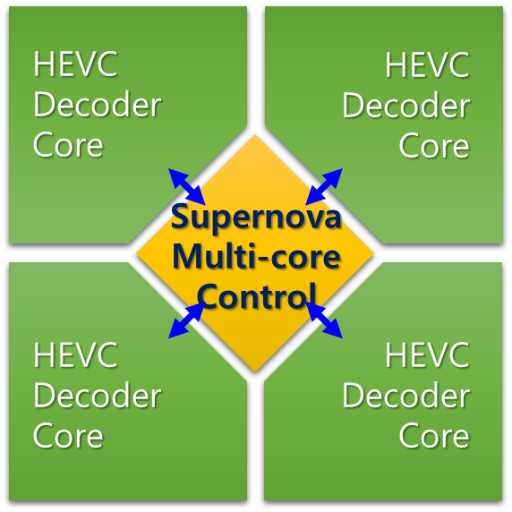
Multi-core 기반 확장성
Multi-core를 기반으로 HEVC 병렬처리 기술을 완벽히 지원
Wavefront Parallel Processing (WPP)
Tiles
Core#0
Core#0
Core#1
Core#1
Core#2
Core#3
Core#0
Core#2
Core#3
Core#1
Core#2
Core#3
화면경계의 효율적 in-loop filtering 기술 (국제특허, SCI 논문)
Multi-core 운용을 위한 stream pre-parser 및 controller 내장
Single/Dual/Triple/Quad-core로 자유롭게 운용가능
Memory bandwidth 절약기술 (Cache) 적용
Core간 workload balancing
최대 135개 WPP partition 지원
최대 110개의 tile 지원
Notes:
The feature of EMP is summarized as ultra-low-power, small and fast signal processing.
We view the markets for EMP as audio and real-time control.
As the microcontroller requires more and more real-time control, we believe that microcontroller may need DSP features implemented in the embedded core.
The microcontroller platform based on EMP includes IPs for MCU and EMP core as the central processing core.

Slide 8



Low-power mode
ETRI IP: 약 30% 소비전력 절감
Residuals in normal mode
원본영상
Residuals in low-power mode (약 50%의 residual 감소)
Notes:
The feature of EMP is summarized as ultra-low-power, small and fast signal processing.
We view the markets for EMP as audio and real-time control.
As the microcontroller requires more and more real-time control, we believe that microcontroller may need DSP features implemented in the embedded core.
The microcontroller platform based on EMP includes IPs for MCU and EMP core as the central processing core.

Slide 9


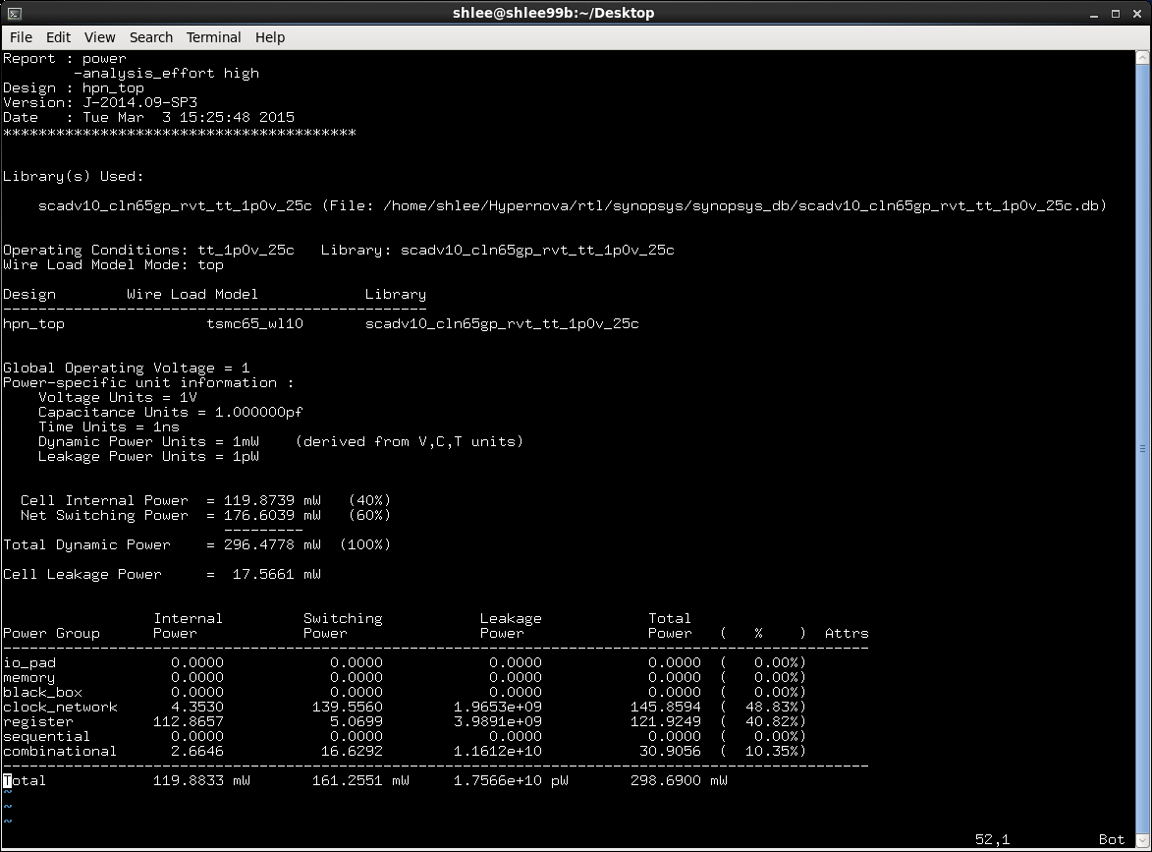
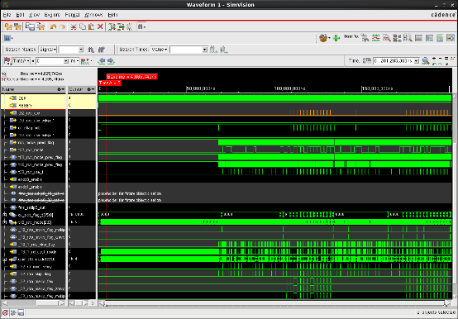
소비 전력
게이트 수준 소비전력 측정 : 300MHz @65nm CMOS, 1.0V, 25C
with Synopsys® Power Compiler (Ver. J-2014.09-SP3)
[ Normal mode]
[Low power mode]
read_saif –input
switching_activity.file
Normal Mode: 298.7mW
23.8% 감소
Low Power Mode: 227.6mW
Notes:
The feature of EMP is summarized as ultra-low-power, small and fast signal processing.
We view the markets for EMP as audio and real-time control.
As the microcontroller requires more and more real-time control, we believe that microcontroller may need DSP features implemented in the embedded core.
The microcontroller platform based on EMP includes IPs for MCU and EMP core as the central processing core.

Slide 10
검증 플랫폼
SoC 환경을 고려한 시스템수준 검증
Notes:
The feature of EMP is summarized as ultra-low-power, small and fast signal processing.
We view the markets for EMP as audio and real-time control.
As the microcontroller requires more and more real-time control, we believe that microcontroller may need DSP features implemented in the embedded core.
The microcontroller platform based on EMP includes IPs for MCU and EMP core as the central processing core.

Slide 11
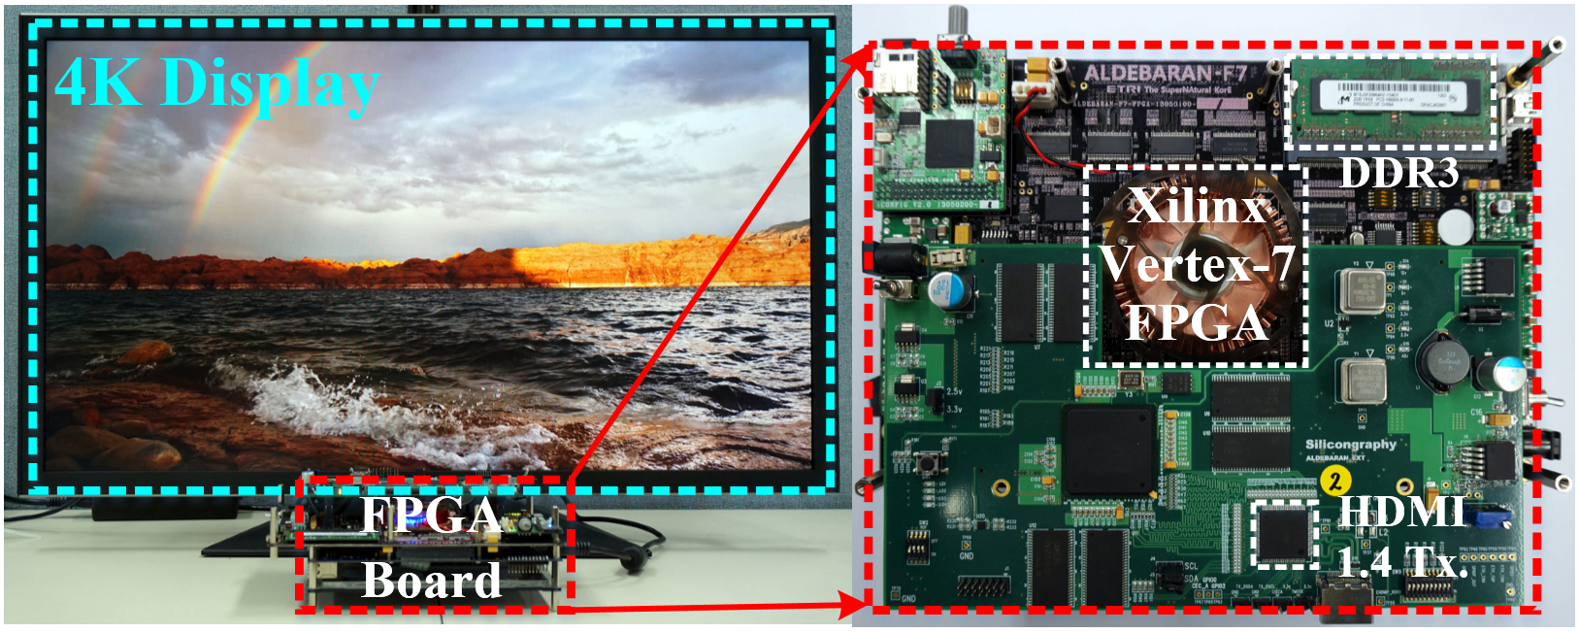
FPGA 플랫폼
Supernova HEVC 디코더
특징: Aldebaran 프로세서 + Dual-core 4K-UHD HEVC 디코더
- Xilinx Vertex-7, DDR2/3 and HDMI-1.4 Tx
Notes:
The feature of EMP is summarized as ultra-low-power, small and fast signal processing.
We view the markets for EMP as audio and real-time control.
As the microcontroller requires more and more real-time control, we believe that microcontroller may need DSP features implemented in the embedded core.
The microcontroller platform based on EMP includes IPs for MCU and EMP core as the central processing core.

Slide 12
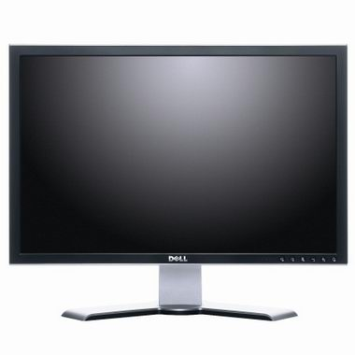

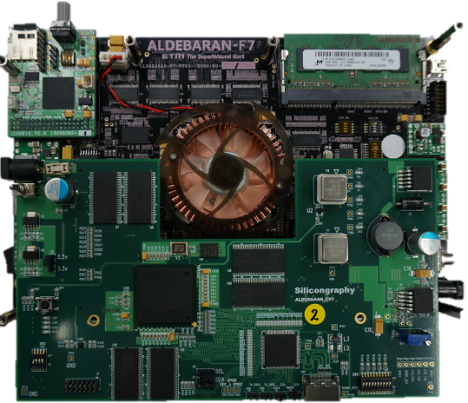
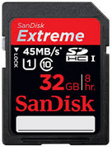
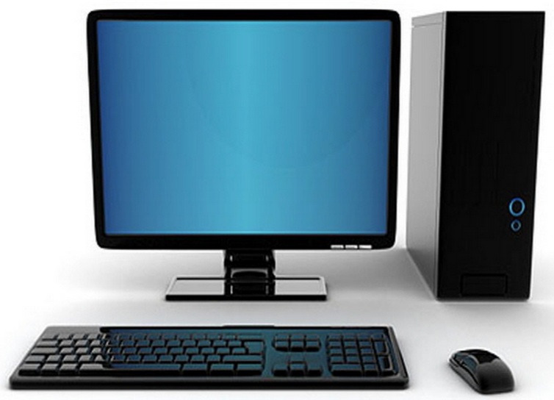
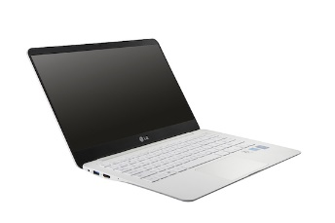
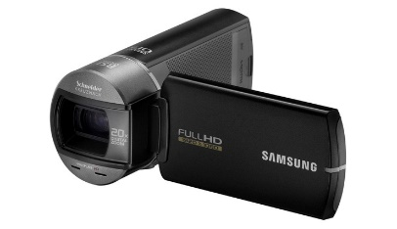
FPGA 플랫폼
Hypernova HEVC 인코더
Hypernova HEVC 인코더 검증보드 (ALDEBARAN-F7)
HDMI out
Bitstream 저장
인코딩 중인 영상 확인
JTAG
HDMI in
범용 SW HEVC 디코더에서 Bitstream 디코딩 최종확인
FPGA 보드 제어
원본영상 입력
Notes:
The feature of EMP is summarized as ultra-low-power, small and fast signal processing.
We view the markets for EMP as audio and real-time control.
As the microcontroller requires more and more real-time control, we believe that microcontroller may need DSP features implemented in the embedded core.
The microcontroller platform based on EMP includes IPs for MCU and EMP core as the central processing core.

Slide 13
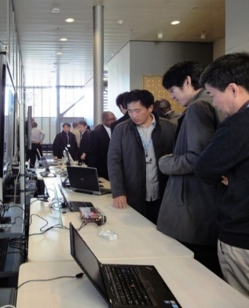
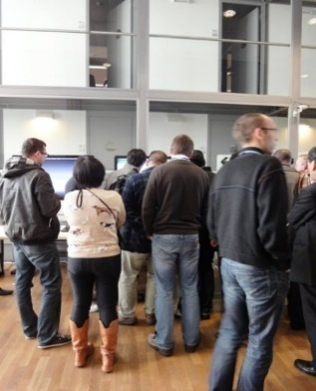
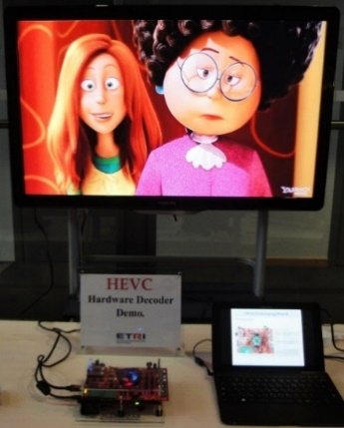
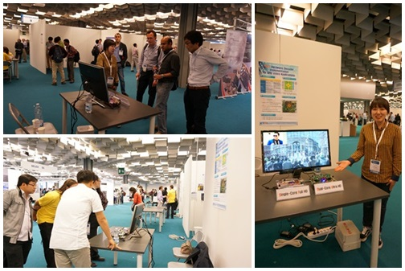
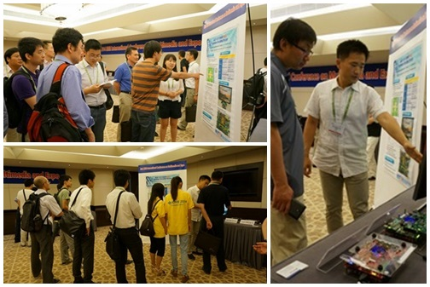
기술 홍보
제12차 JCT-VC 국제표준회의 공개시연 (2013. 1. 16, 스위스 제네바) “Better Quality of Life through ITU-T Recommendations”
IEEE International Conference on Acoustics, Speech, and Signal Processing (ICASSP),
2014. 5. 8, 이탈리아 피렌체
IEEE International Conference on Multimedia and Expo (ICME),
2014. 7. 18, 중국 청두
Notes:
The feature of EMP is summarized as ultra-low-power, small and fast signal processing.
We view the markets for EMP as audio and real-time control.
As the microcontroller requires more and more real-time control, we believe that microcontroller may need DSP features implemented in the embedded core.
The microcontroller platform based on EMP includes IPs for MCU and EMP core as the central processing core.

Slide 14
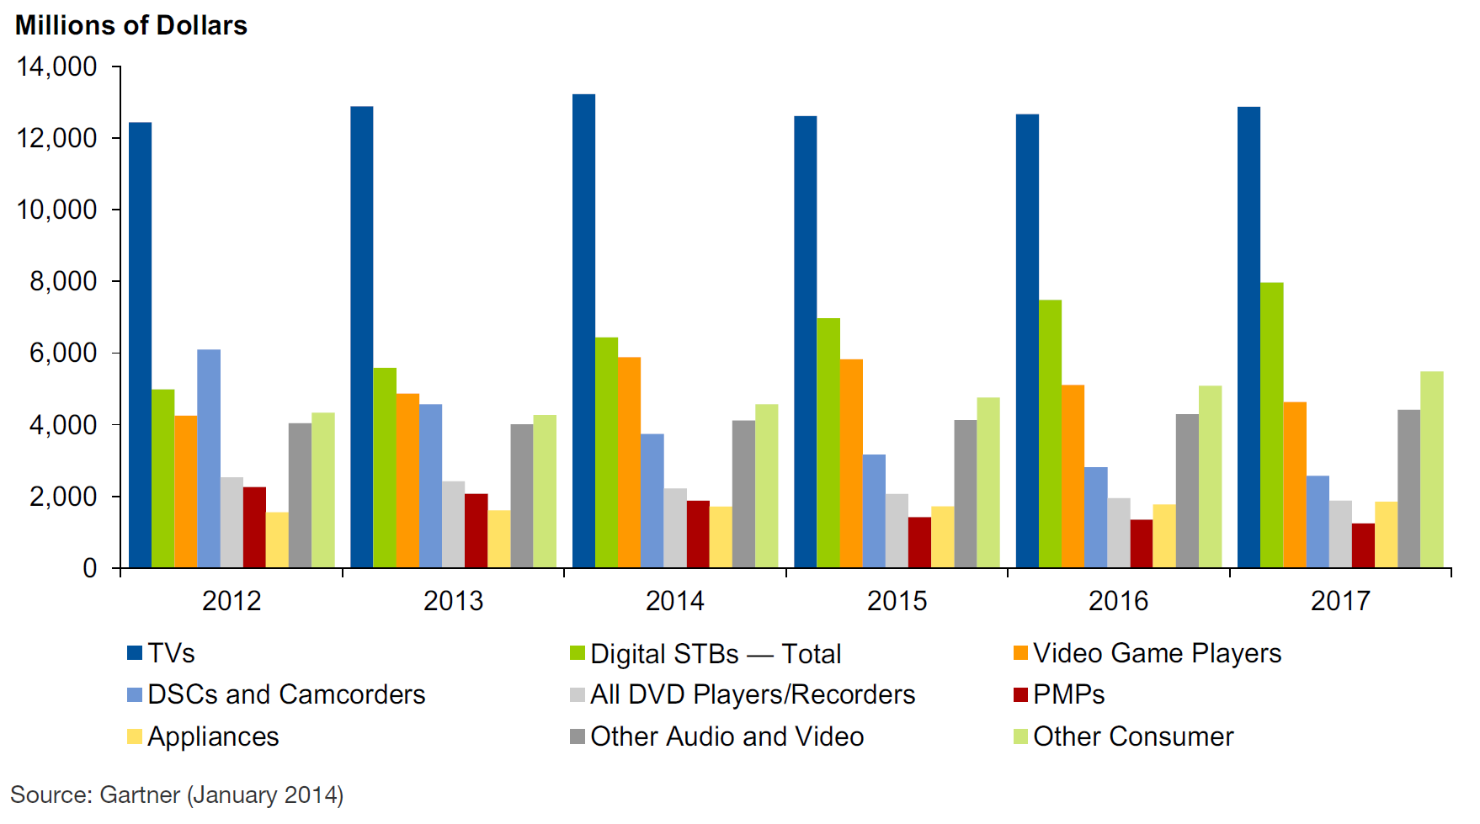
시장 현황
해외시장 현황
HEVC 코덱기반 컨슈머 시장은 진입기, 향후 2~5년 내에 크게 증가할 전망
비디오 디바이스 ‘14년 세계판매량 규모는 약 438억불 전망
(연평균 24% 성장)
출처: Gartner, 2014.01
국내시장 현황
블랙박스, 스포츠캠, 초선명네트워트 카메라 HEVC 응용시스템시장 ‘14년 국내판매량 규모는 약 5조, 연평균 20% 성장 (출처: IMS, Yano Research, 2013)
2014년 4K 지상파, 케이블, 위성, IPTV UHDTV 시험방송으로 HEVC 코덱에 대한 수요 급증
국내 대기업 및 팹리스 업체 중심으로 4K급 HEVC 코덱을 개발 중
Notes:
The feature of EMP is summarized as ultra-low-power, small and fast signal processing.
We view the markets for EMP as audio and real-time control.
As the microcontroller requires more and more real-time control, we believe that microcontroller may need DSP features implemented in the embedded core.
The microcontroller platform based on EMP includes IPs for MCU and EMP core as the central processing core.

Slide 15
기술 사업화
사업화 대상 기업
국내기업을 위한 IP 라이센싱 및 기술이전 가능
팹리스 반도체기업
UHDTV, IPTV STB, DVR, 스포츠캠, 차량용 블랙박스 시스템 개발기업
상용화 기술개발 초기부터 개발기관과 수요기업이 협력가능
요구사항 정의, 상용화에 주력하여 시장상황에 부합한 제품개발 가능
사업화 기대효과
경쟁력있는 솔루션을 제공, 국내개발 업체의 시장진입에 기여
외산 경쟁제품 대비 차별화된 핵심 IP제공으로 관련시장 성장기에 가격경쟁력 확보
HEVC 코덱 SoC 기술로 국내개발 업체의 세계시장 경쟁력 확보
Notes:
The feature of EMP is summarized as ultra-low-power, small and fast signal processing.
We view the markets for EMP as audio and real-time control.
As the microcontroller requires more and more real-time control, we believe that microcontroller may need DSP features implemented in the embedded core.
The microcontroller platform based on EMP includes IPs for MCU and EMP core as the central processing core.

Slide 16


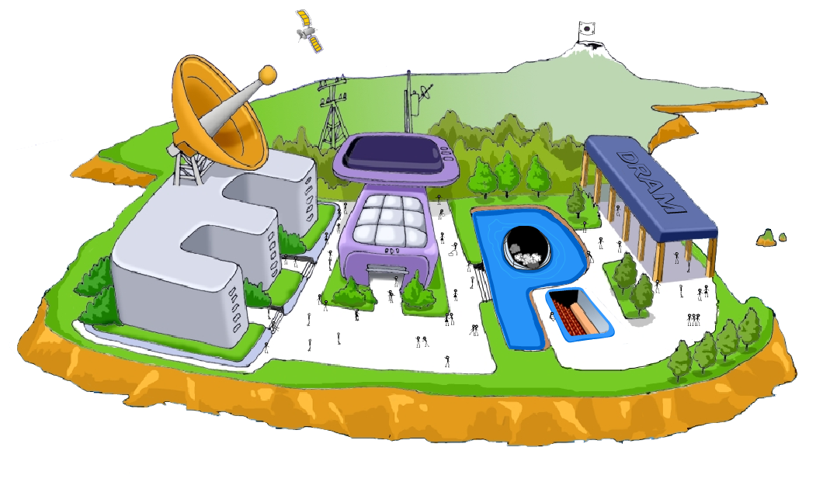

기술
문의
멀티미디어프로세서연구실/실장 : 변경진
Tel : (042) 860-5831 / E-Mail : kjbyun@etri.re.kr
Electronics and Telecommunications Research Institute

